Slide 1
Rockbuster: the State of the Business
Sebastian Lombardo

Slide 2

Scope of Analysis
1. Films – Highest and Lowest Revenue
Give the people what they want (and throw out what they don’t)!
2. Rental Duration
Viewing habits and other statistics
3. Customer Locations
Where are they?
4. Loyal Customer Locations
But where are they really?
5. Sales by Geography
What do they want from us?

Slide 3
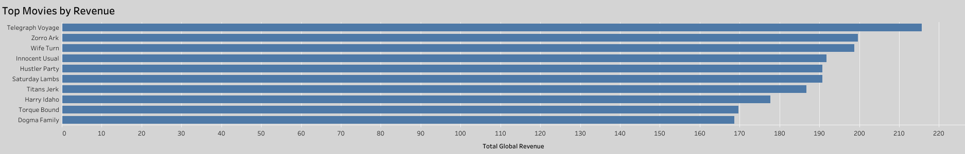
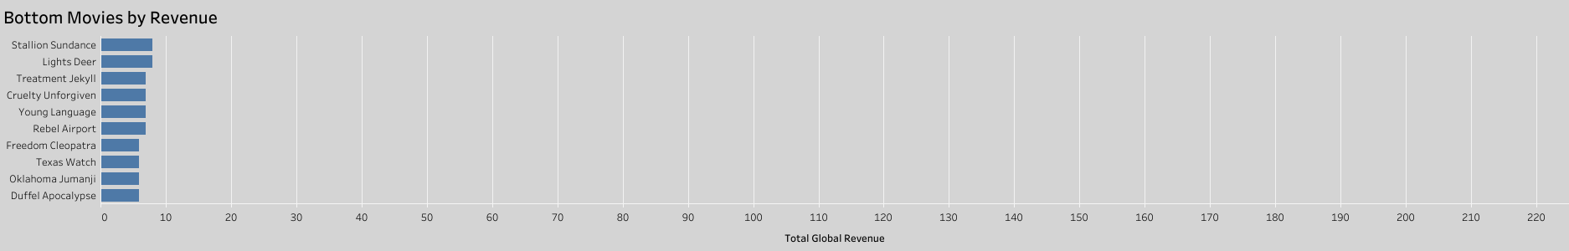
Keep these in stock!
Total Revenue: $1890.40
Don’t waste the shelf space...
We do not need to stock movies that are not paying for themselves.
Total Revenue: $67.38

Slide 4


How are they using our services?
Rental Duration
Low:
High:
Rental Rate
Low:
High:
3 days
7 days
$0.99
$4.99
“Average Film: the Movie!”
Rental Duration: 5 days
Rental Rate: $2.98
Film Length: 115 minutes
Film Length
Low:
High:
Replacement Cost: $19.98
Replacement Cost
Low:
High:
46 minutes
185 minutes
$9.99
$29.99

Slide 5
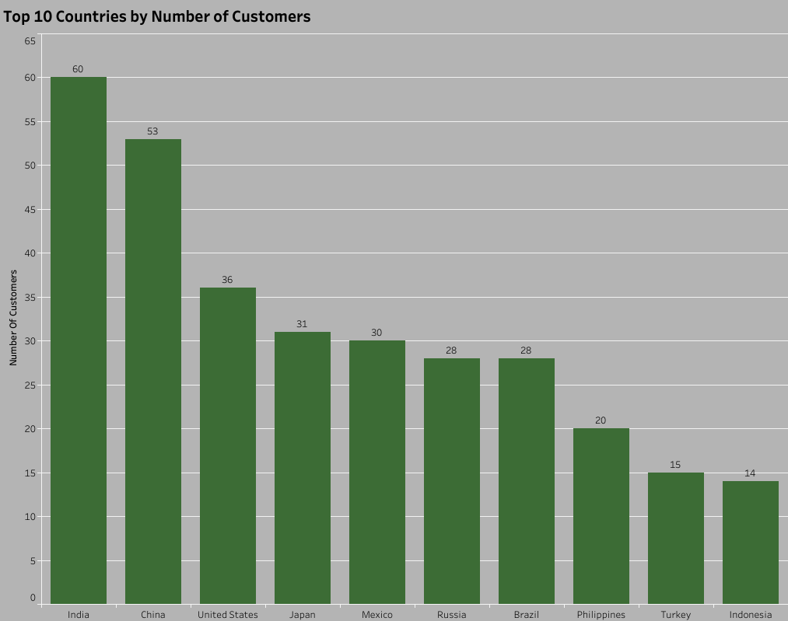
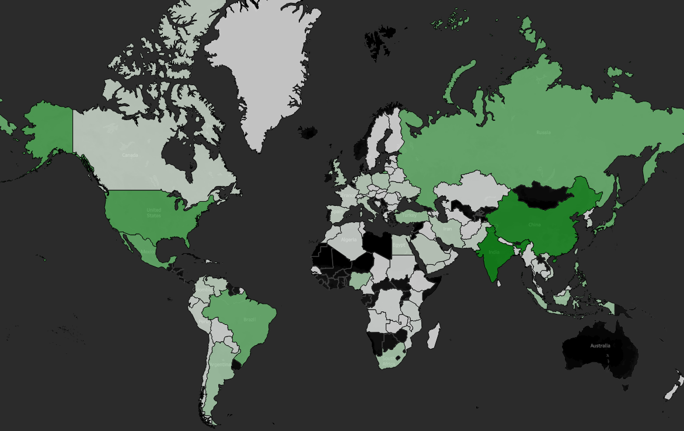
Where are our customers?
India
China
United States
Japan
Mexico
Russia
Brazil
Philippines
Turkey
Indonesia

Slide 6
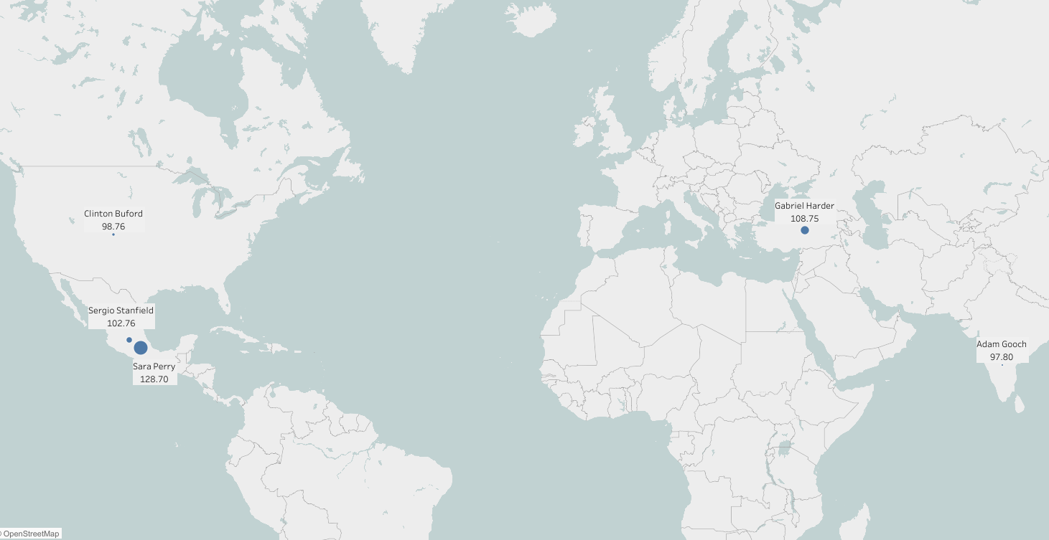
Loyal Customers
(Targeted)
Top 5 Customers
In Top 5 Cities
In Top 5 Countries
Sara Perry ($128.70)
Atlixco, Mexico
Gabriel Harder ($108.75)
Sivas, Turkey
Sergio Stanfield ($102.76)
Celaya, Mexico
Clinton Buford ($98.76)
Aurora, CO, US
Adam Gooch ($97.80)
Adoni, India
For promotional purposes in
targeted, high visibility cities

Slide 7
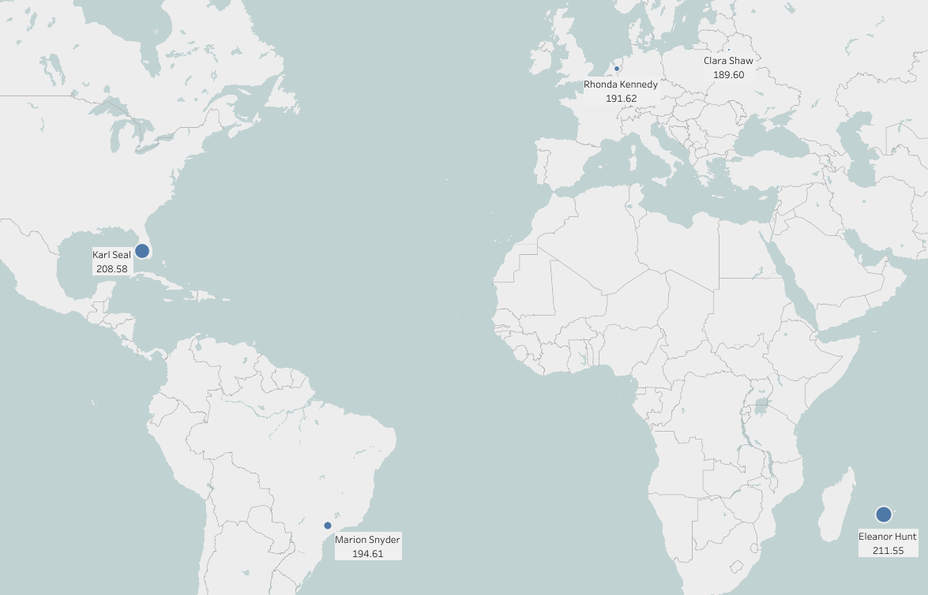
Loyal Customers
(Worldwide)
Top 5 Customers
Eleanor Hunt ($211.55)
Saint-Denis, Réunion
Karl Seal ($208.58)
Cape Coral, FL, US
Marion Snyder ($194.61)
Santa Barbara d’Oeste, Brazil
Rhonda Kennedy ($191.62)
Apeldoorn, Netherlands
Clara Shaw ($189.60)
Molodechno, Belarus

Slide 8
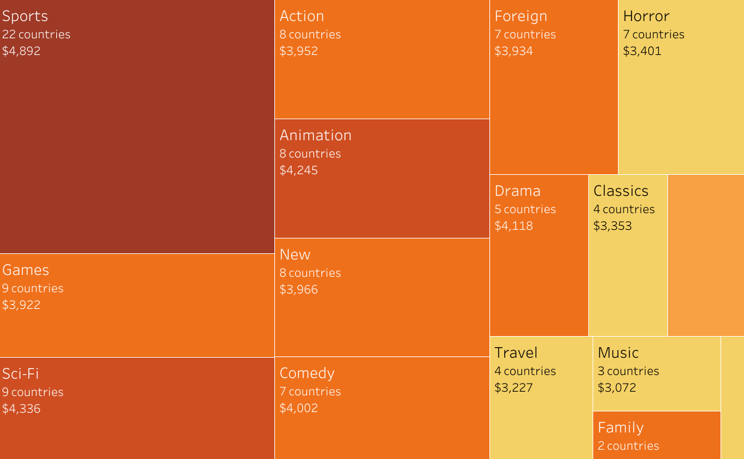
Top Selling Genres
Size is proportional to the total global revenue from the genre
Shade gets darker with the number of countries claiming the genre as its top seller
India
United States
Mexico
Brazil
Indonesia
China
Philippines
Top 10 Countries’
Top Selling Genres are indicated on the chart
Turkey
Japan
Russia

Slide 9

Conclusions
1. Films that do not bring in at least $20 in revenue are not worth keeping in stock
2. Customers are done renting a film after a week
3. Our worldwide customer base is very small. Our highest numbers of customers are in, predictably, high population countries.
Customers pinpointed for Loyalty Rewards can be chosen in the most active cities for higher visibility...
5. ...though that would ignore—and possibly upset—the customers most loyal to us that do not live in the most active cities.
6. We can plan inventory by stocking more of the genres that appeal to a given country’s preferences.

Slide 10
Links to Interactive Visualizations
Top Movies by Revenue
https://public.tableau.com/app/profile/sebastian5242/viz/TopMoviesbyRevenue/Sheet1
Bottom Movies by Revenue
https://public.tableau.com/app/profile/sebastian5242/viz/BottomMoviesbyRevenue/Sheet12
Top Selling Genres Worldwide
https://public.tableau.com/app/profile/sebastian5242/viz/TopSellingGenresWorldwide/TopSellingGenres
Top 10 Countries by Number of Customers
https://public.tableau.com/app/profile/sebastian5242/viz/3_10PresentingSQLResults/Sheet1
Top 5 Customers in Top Cities
https://public.tableau.com/app/profile/sebastian5242/viz/Top5CustomersinTopCitiesMap/Sheet2
Top 5 Customers Worldwide
https://public.tableau.com/app/profile/sebastian5242/viz/Top5CustomersMap_16777961454470/Top5CustomersWorldwide
All Customers by Country
https://public.tableau.com/app/profile/sebastian5242/viz/CustomersbyCountry_16780621562880/Sheet3

